Slide 1
A-Team
Project 6X6 Tic Tac Toe Game
By Ibra, Eddie, Jason, Carrie, Alexis, Alfonso

Slide 2
Introduction
Classic Tic-Tac-Toe:
Two players
3x3 grid
First with three in row wins
Our project:
One or two players
6x6 grid
Player with the most four in a row wins

Slide 3
Purpose of the Game
Purpose: win against your opponent.
The winner will be determined once the entire grid is filled.
The player with the most 4 in a row wins:
Vertically
Horizontally
Diagonally
Have fun playing.
Notes:
GOALS: To play the game during downtime, to be entertained and to win the game.
TASKS:
3

Slide 4
How the game will work
User will be given a login menu.
User can either log in or register.
The user selects:
Player vs. Player (PvP)
Player vs. A.I.(PvA)
The player's status will be saved in the database via their unique username.

Slide 5
New User Requirements
New User Requirements:
Register user by:
Unique username
Unique password
Now User can choose PvP or PvA.

Slide 6
Existing User Requirements
Existing User Requirements:
Username and password require.
Once authenticated, main menu will be presented
User can choose PvP or PvA.
Notes:
GOALS: To play the game during downtime, to be entertained and to win the game.
TASKS:
6

Slide 7
Special case of Player vs Player
Player vs Player:
Log in and choose PvP.
Game starts as Player vs Player.
Update the score as squares connect.
Notes:
GOALS: To play the game during downtime, to be entertained and to win the game.
TASKS:
7

Slide 8
Special case of Player vs AI
Player vs AI:
Log in and choose PvA.
Game starts as Player vs AI.
Update the score as squares connect.

Slide 9
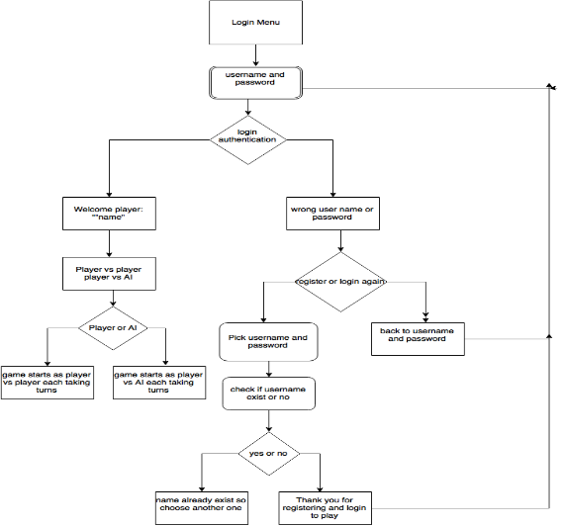
Game flow diagram

